Slide 1


CSS Text and Fonts

Slide 2

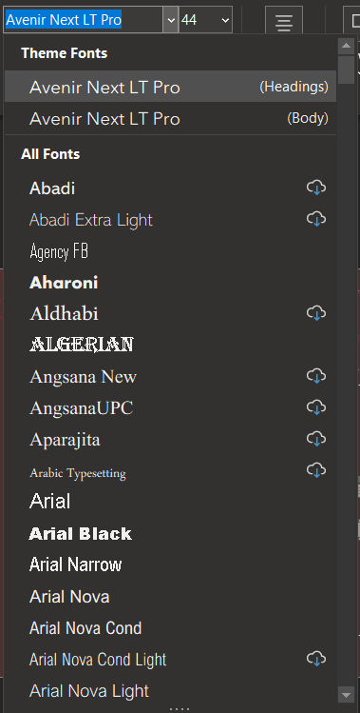
Text and Fonts
A typical word doc probably has this function for you to choose your font and other settings.
In web design, we use CSS to edit these elements.

Slide 3
Basics
Color
Background-color
Text-align
Direction
Notes:
e.g. p {
color : rgb(0,0,0);
}

Slide 4
Vertical-align
img.top { vertical-align: top; }
img.middle { vertical-align: middle; }
img.bottom { vertical-align: bottom; }
<p>An <img class="top" src=“some_img.png" alt=“some image" width="270" height="50"> image with a top alignment.</p><br>
Notes:
Guess which css is the correct syntax? Img.top
Left is CSS right is HTML
This would set the image to align with the paragraph using vertical-align.

Slide 5
Text-decoration
h1 { text-decoration: overline; }
h2 { text-decoration: line-through; }
h3 { text-decoration: underline; }
<h1>This is heading 1</h1>
<h2>This is heading 2</h2>
<h3>This is heading 3</h3>
Notes:
Left is CSS right is HTML
This would set the image to align with the paragraph using text-decoration.

Slide 6
Text-transformation
p.uppercase { text-transform: uppercase; }
p.lowercase { text-transform: lowercase; }
p.capitalize { text-transform: capitalize; }
<p class=“lowercase">This is some text.</p>
Notes:
Guess which css is the correct syntax? P.lowercase
Left is CSS right is HTML
This would set the image to align with the paragraph using text-transformation.

Slide 7
Text-indentation
p { text-indent: 50px; }
<p class=“lowercase">This is some text.</p>
<p class=“test">This is some text.</p>
<p class=“hello">This is some text.</p>
Notes:
Is this syntax correct? No. Why? It’ll be used for all p, but I only want for hello. Then how? Use p.hello {};
Left is CSS right is HTML
This would set the image to align with the paragraph using text-transformation.

Slide 8
Letter Spacing
h1 { letter-spacing: 3px; }
h2 { letter-spacing: -3px; }
<h1>This is some text.</h1>
<h2>This is some text.</h2>
Notes:
If I want to have both h1 size, how can I go about it?
Use class to distinguish between the 2.

Slide 9
Line Height
p.small { line-height: 0.8; }
p.big { line-height: 1.8; }
<p class="small">
This is a paragraph with a smaller line-height.<br>
This is a paragraph with a smaller line-height.<br>
</p>
<p class="big">
This is a paragraph with a bigger line-height.<br>
This is a paragraph with a bigger line-height.<br>
</p>
Notes:
Default is 110% - 120%.
Aka spacing between every new line.

Slide 10
Word Spacing
h1 { word-spacing: 10px; }
h2 { word-spacing: -5px; }
<h1>This is some text.</h1>
<h2>This is some text.</h2>
Notes:
Specify the space between the words in a text

Slide 11
White Space
p { white-space: nowrap; }
<p>This is some text.</p>
Notes:
Wrap overflow characters or unwrap

Slide 12

Text-shadow
p { text-shadow: 2px 2px 5px red; }
<p>Text-shadow effect!</p>
Notes:
Syntax: horizontal shadow, vertical shadow, blurriness, colour

Slide 13
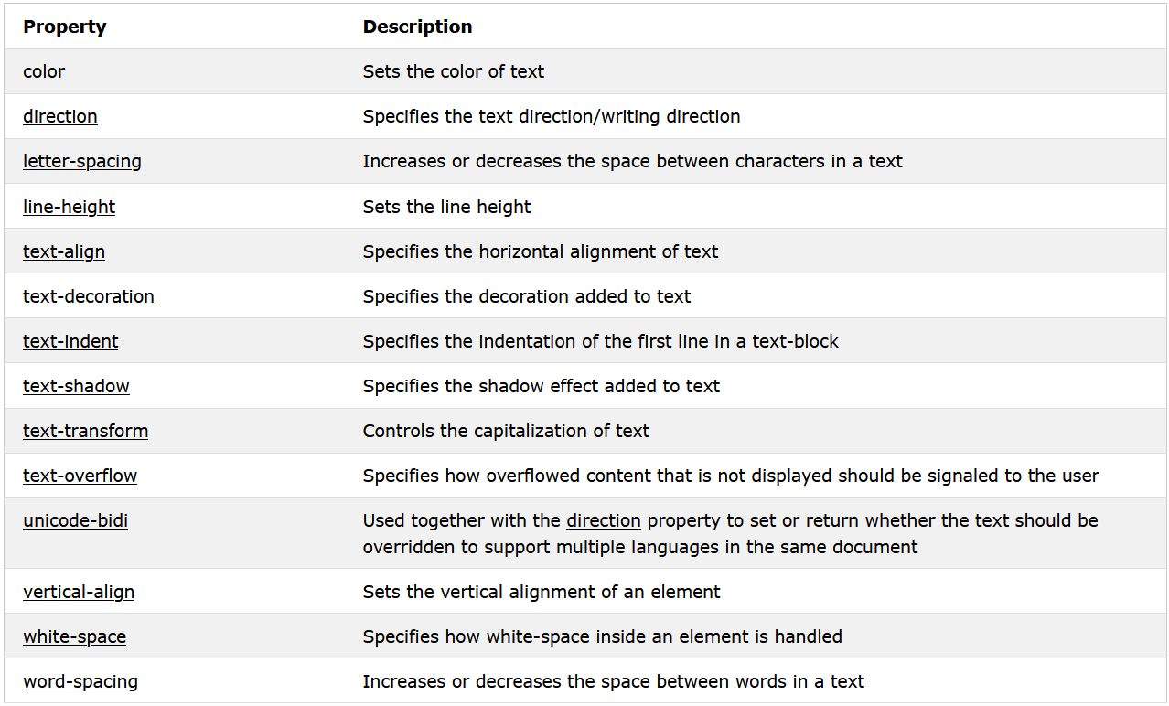
Summary

Slide 14
Font-family
.p1 { font-family: "Times New Roman", Times, serif; }
p2 { font-family: Arial, Helvetica, sans-serif; }
p3 { font-family: "Lucida Console", "Courier New", monospace; }
<h1>CSS font-family</h1>
<p class="p1">This is a paragraph, shown in the Times New Roman font.</p>
<p class="p2">This is a paragraph, shown in the Arial font.</p>
<p class="p3">This is a paragraph, shown in the Lucida Console font.</p>
Notes:
If more than 1 word, use “ “.
Start with the font you want, and end with a generic family (to let the browser pick a similar font in the generic family, if no other fonts are available).
The font names should be separated with comma.

Slide 15
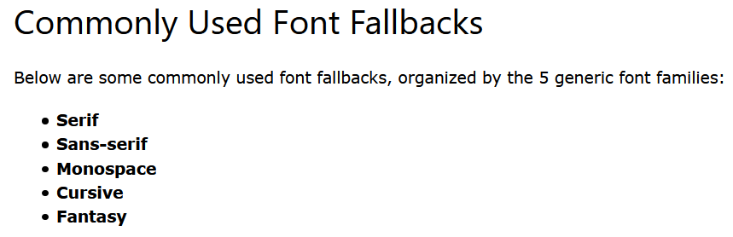

Slide 16
Basics
Font-style
Font-weight
Font-variant

Slide 17
Using Google Fonts
Add a special style sheet in the <head> section.
Then thereafter, we can refer to it as per normal in CSS.
Good to always have one fallback font (compatibility issue).

Slide 18
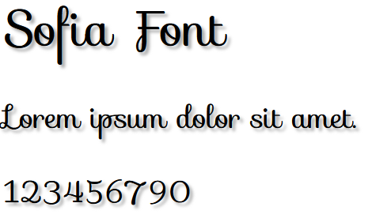
Using of Multiple Google Fonts
<head> <link rel="stylesheet" href="https://fonts.googleapis.com/css?family=Audiowide|Sofia|Trirong"> <style> h1.a {font-family: "Audiowide", sans-serif;} h1.b {font-family: "Sofia", sans-serif;} h1.c {font-family: "Trirong", serif;} </style> </head>

Slide 19

Enabling Font Effects
<head> <link rel="stylesheet" href="https://fonts.googleapis.com/css?family=Sofia&effect=fire"> <style> body { font-family: "Sofia", sans-serif; font-size: 30px; } </style> </head> <body> <h1 class="font-effect-fire">Sofia on Fire</h1> </body>
Notes:
Of course, we can select multiple using “|” pipe character as well for effect.
Visit https://fonts.google.com/ for more fonts.

Slide 20
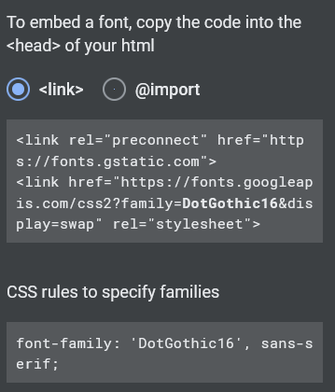
Using https://fonts.google.com/
Google allows you to copy the necessary syntax into our script!
Read the doc at: https://developers.google.com/fonts/docs/css2

Slide 21
Task 8
Remember Task 7 where we created a webpage with a floating icon?
Open Task 7.
Go to Google font, look for a nice font of your choice, pick a complimentary pair.
Change the Fonts to make them look good.

